Slide 1









Dawn Editor
Project URL
Flavor
github://phookdk/dawn
add
pure
dawn
flavors
add
concatenate
console
index
console
Flavor
pure
localstorage:/> _

Slide 2




Dawn Editor
Project URL
View
ftp:/phook.dk
add
pure
Login needed
The ftp protocol needs login
for read access
console
Flavor
pure
localstorage:/> _

Slide 3
Dawn Editor
Project URL
View
github://phookdk/dawn
index
structure
dawn
rows
flavors
add
columns
concatenate
console
layers
index
filler
{:template
{col
{filler}
{:content}
{filler}
}
}
templates
console
Flavor
pure
localstorage:/> _

Slide 4

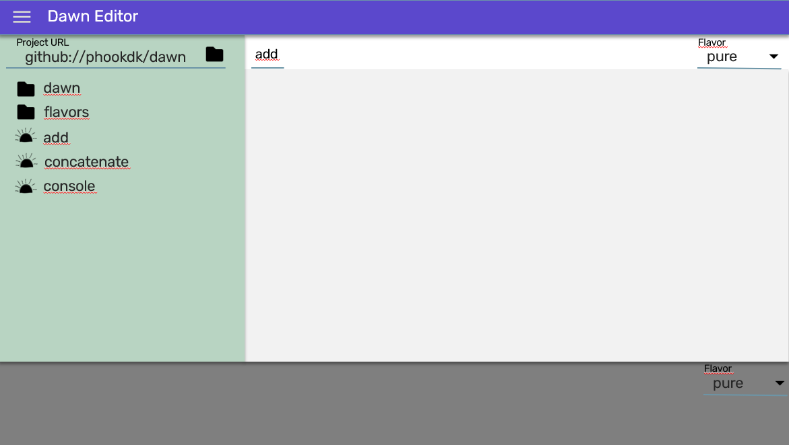
open the tutorial
visit dawn on Github
open IDE
Clumsily hacked together by phook the limb imposter
Source on Github

Slide 5

open the tutorial
visit dawn on Github
open IDE
Clumsily hacked together by phook the limb imposter
Source on Github

Slide 6


Slide 7
Ideas for new desktop
Tiles:
Compose workscreens by tiling apps
Switching between workscreens
Saving workscreens as apps
Launching apps (fullscreen and into workscreen)
Custom apps – no code builds
Automating tasks (inspiration maya)
apps can offer different screens for the tiling – can be use to configure a single app
Apps are just urls – appicon = favicon
Desktop should have options for autologin

Slide 9
Dawn Editor
Project URL
Flavor
github://phookdk/dawn
add
sub
pure
dawn
flavors
add
concatenate
console
index
console
Flavor
pure
localstorage:/> _

